Slide 1

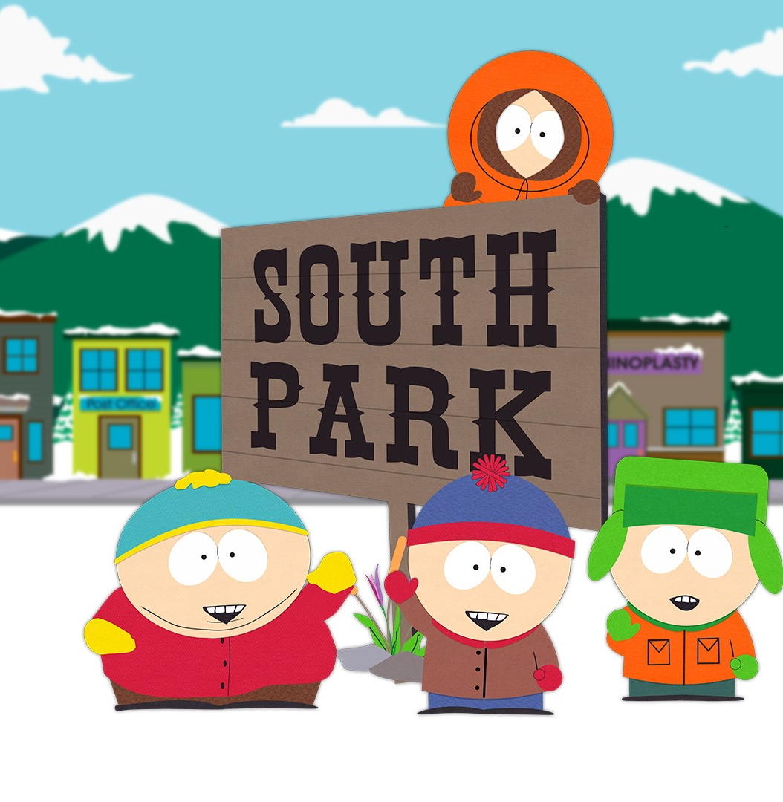
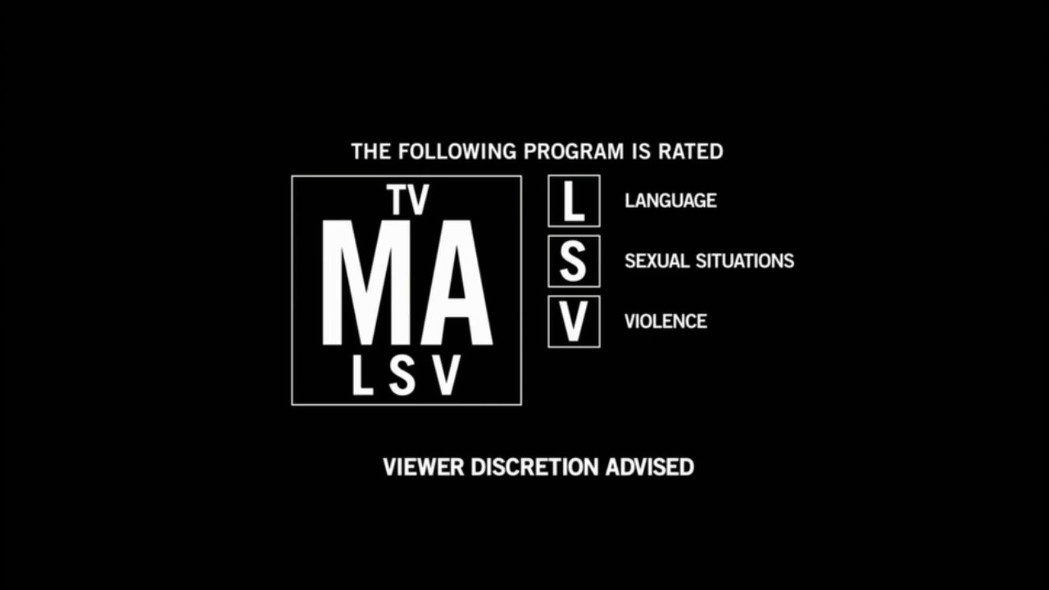
Tegridy Farms
Data Analysis with Tegridy
Notes:
Nashra

Slide 2
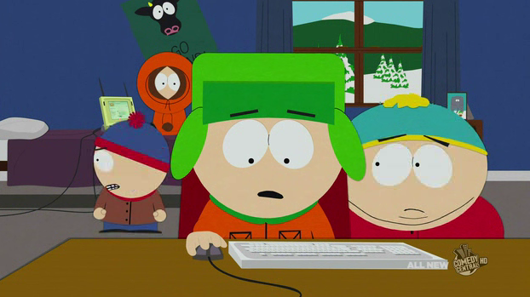
The Background: South Park is an comedic animated sitcom that has aired on Comedy Central for over 25 years Shows theme and adult humor: Dark Profane Social Satire Political Shows popularity and creators
*This is us beginning our project
Notes:
Nashra South Park is an comedic animated sitcom that has aired on Comedy Central for over 25 years. It follows a dysfunctional small group of Coloradoan 4th graders and their exploits in the titles hometown. It has became synonymous with dark, profane, sexual innuendo, and adult humor. The show has remained popular and culturally relevant as social satire, pop culture, political references, and numerous other gags have remained the shows bread and butter from the shows hilarious creators Matt Stone and Trey Parker.

Slide 3
Political Correctness Cancel Culture Everything offensive Has one of the most offensive shows softened?
Wait, but what does South Park have to with data analytics?
Notes:
Nashra In our contemporary world of politically correctness, where general consensus of culture shuns, cancels, or otherwise finds most anything offensive this show has indeed remained a constant. After some research and data digging we began to wonder…Has one of the most offensive, infamous, no holds barred shows in history become less offensive as time and culture has progressed? So, this is a quantitative sentiment analysis of the dialogue of the characters, jokes, and offensiveness of the TV series SouthPark. We do a deep dive into the words of SouthPark, over 70,000 lines taken from 18 full seasons, to see if we can pick out some underlying trends to see if one of TV’s most extreme shows has indeed become more socially acceptable.

Slide 4
Hypothesis and the Scientific Method:
Claim: Has SouthPark become less offensive over time?
We will be using sentiment analysis, graphs, correlation, and linear regression using linear equation where M is the slope of the line to see if the slope (shows offensiveness) has become more positive, negative, or remained neutral.
Null Hypothesis: We believe South Park has not changed at all over time!
H₀: M in M = 0
Alternative Hypothesis 1: SouthPark has become less offensive over time
H_{A1}: M < 0
Alternative Hypothesis 2: SouthPark had become more offensive over time
H_{A2}: M > 0
Notes:
Nashra Our groups null hypothesis is that SouthPark has not changed at all in offensiveness over time even as culture has become more sensitive to the type of jokes the SouthPark built its show upon. Our hypothesis is assumed to be true and thus will be tested against the shows extreme language, usage of racial dialogue, radical ideologies, political jokes, religious jokes, and other criteria and parameters to create a sentiment analysis of the shows offensiveness. We will also look at user ratings of seasons or episodes correspond to those characters saying the most slanderous things. We will then use linear regression to determine if the show has become less offensive or more offensive over time and subsequently more or less popular. After our analysis is conducted from the collected data, we will either accept or reject our null hypothesis for the alternative hypothesis which is a.) The shows offensiveness has decreased over time or b.) The shows offensiveness has increased over time.

Slide 5
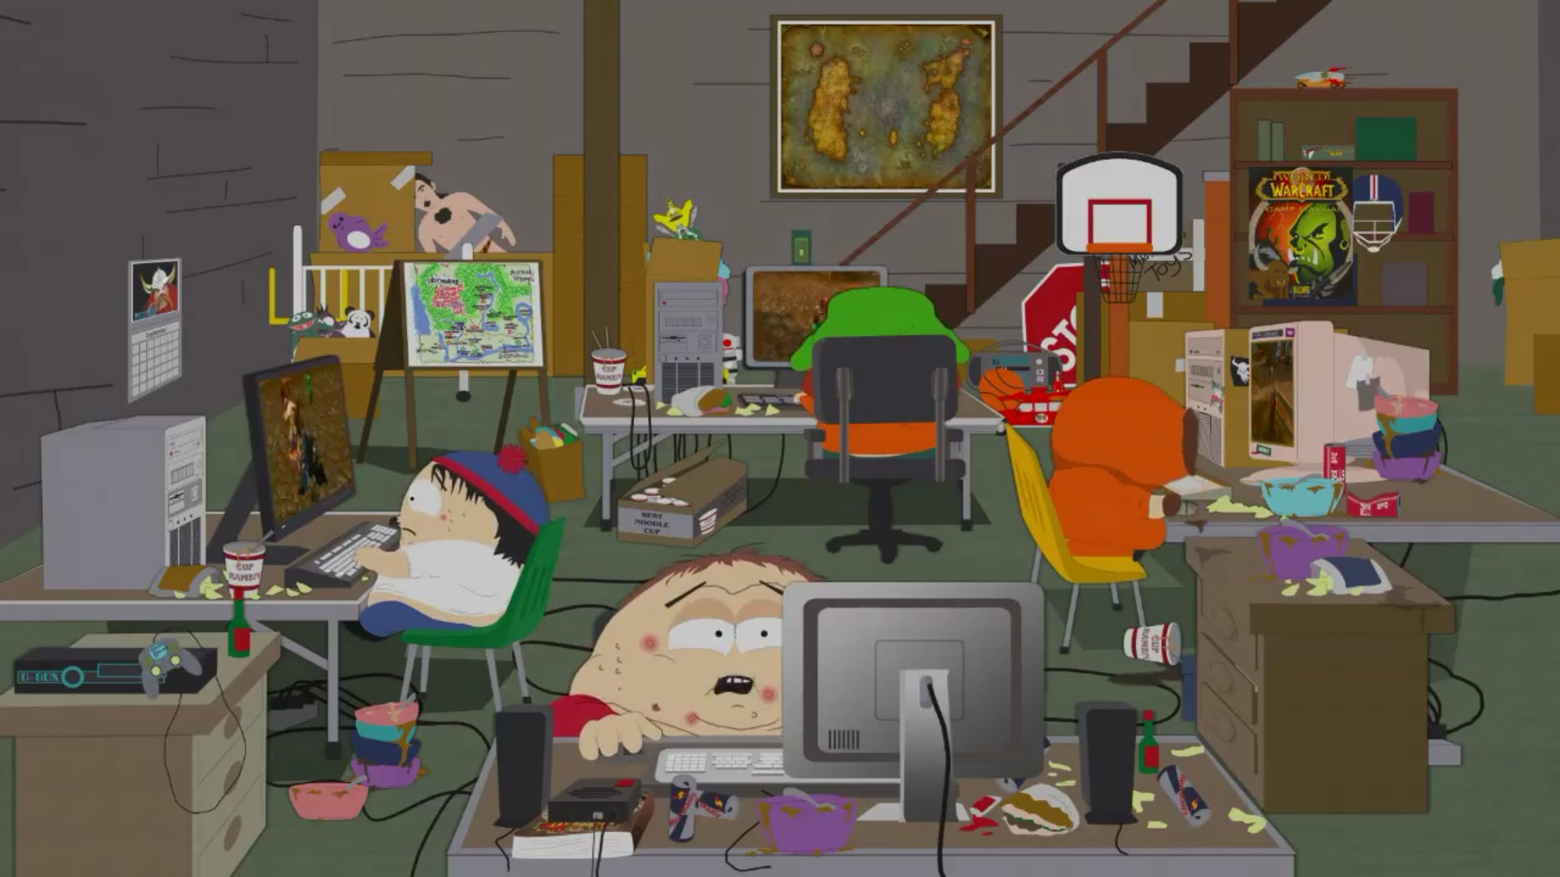
Pseudocoding & Identifying our data source: “South Park Dialogue: More than 70,000 lines of dialogue by season, episode, and character.” via Kaggle
Identifiying our dependencies: NLTK, Sklearn, TermColor, Better_Profanity, TfidVectorizer
Coding
Sentiment Analysis: TextBlob
Analyzing and plotting our results
Our Methods of Analysis
*This is our breakout room
Notes:
Nashra
Pseudocoding & Identifying our data source: “South Park Dialogue: More than 70,000 lines of dialogue by season, episode, and character.” via Kaggle
Identifiying our dependencies: TextBlob, NLTK, Sklearn, TermColor, Better_Profanity, TfidVectorizer, TweetTokenizer as well as matplotlib, pandas, numpy, and a few other libraries.
Coding: Parsing out lines by season, character, and episode. Creating cleaned databases by filtering regular words against swear, profane, racial, political, or offensive words into a list and sorting them by season.
Sentiment Analysis: Running a sentiment analysis to score words as positive or offensive using VaderSentiment.
Analyzing and plotting our results: We used linear regression, sentiment analysis, statistical regression and statistical significance.

Slide 6
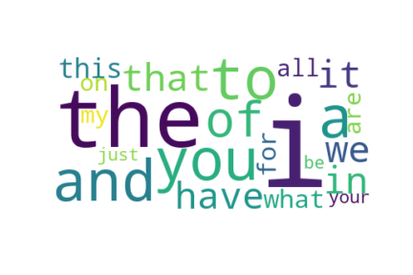
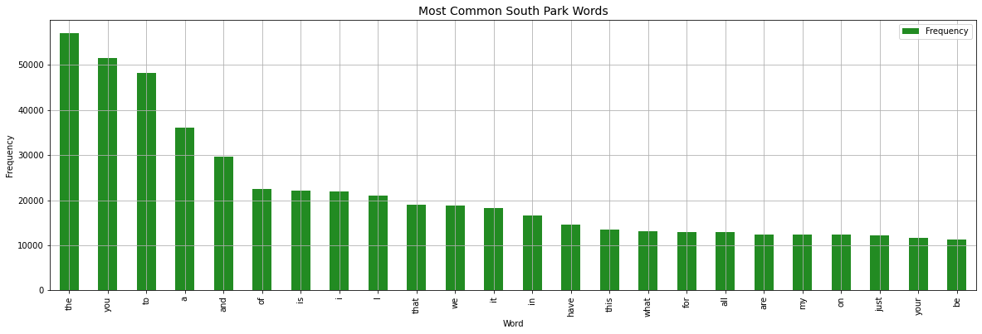
Most Common South Park Words
Notes:
Lynne

Slide 7
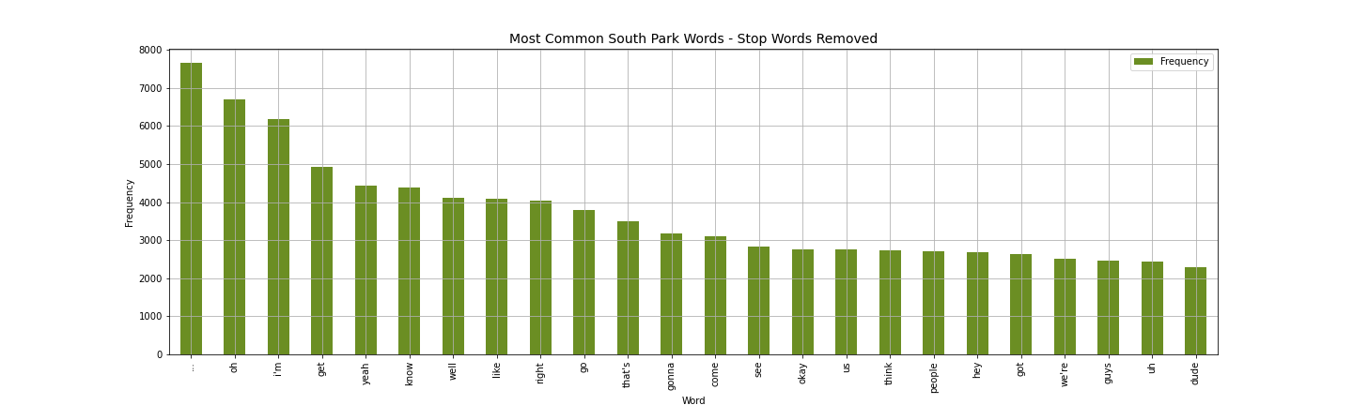
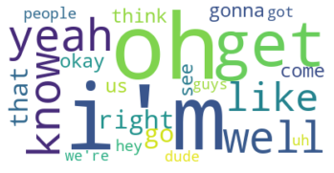
Most Common South Park Words
with ‘Stop Words’ Removed
Notes:
Lynne

Slide 8
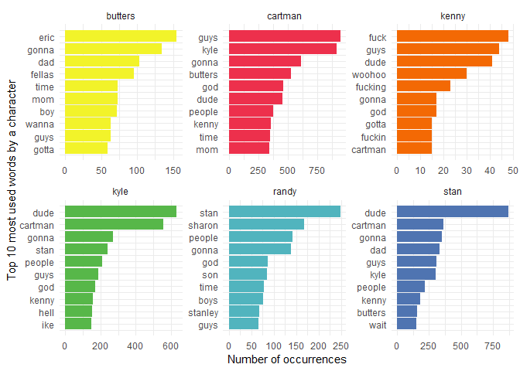
Most Common South Park Words
Notes:
Lynne

Slide 9
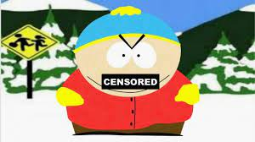
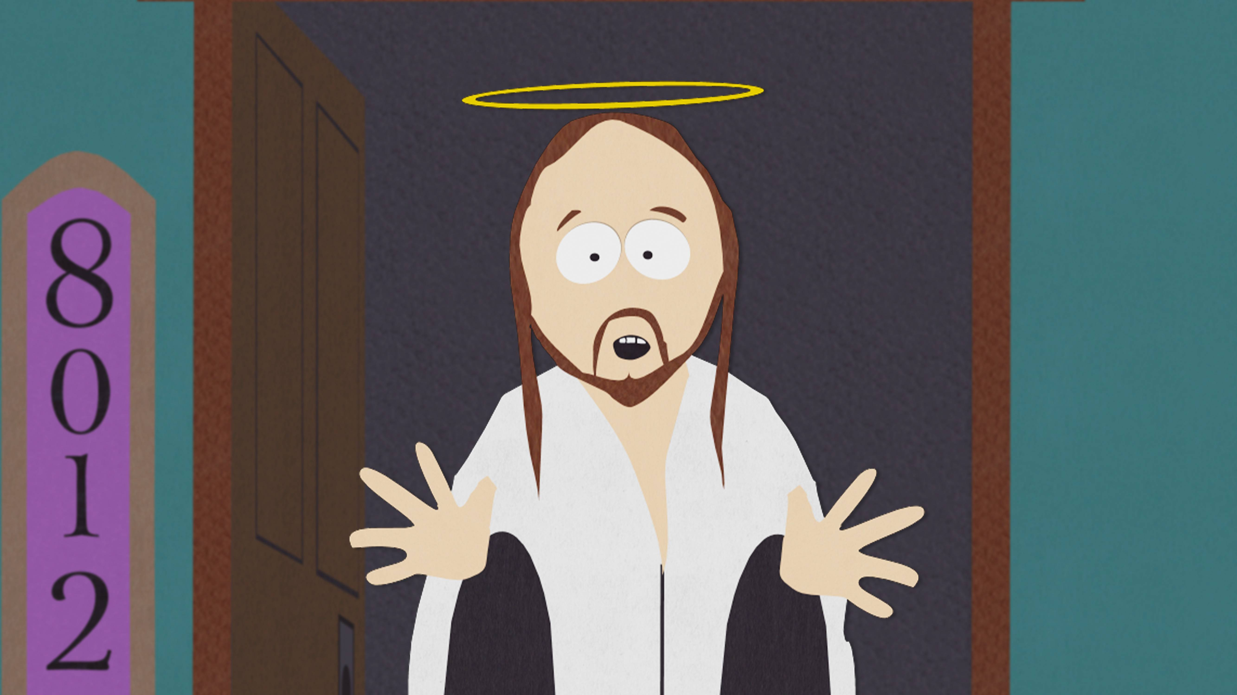
Would the class like to see the swear list we extracted?
Yes, please wake us up!
No, let us see some sentiment analysis!
Please Type “1” in chat
Please Type “2” in chat
Notes:
Lynne

Slide 10
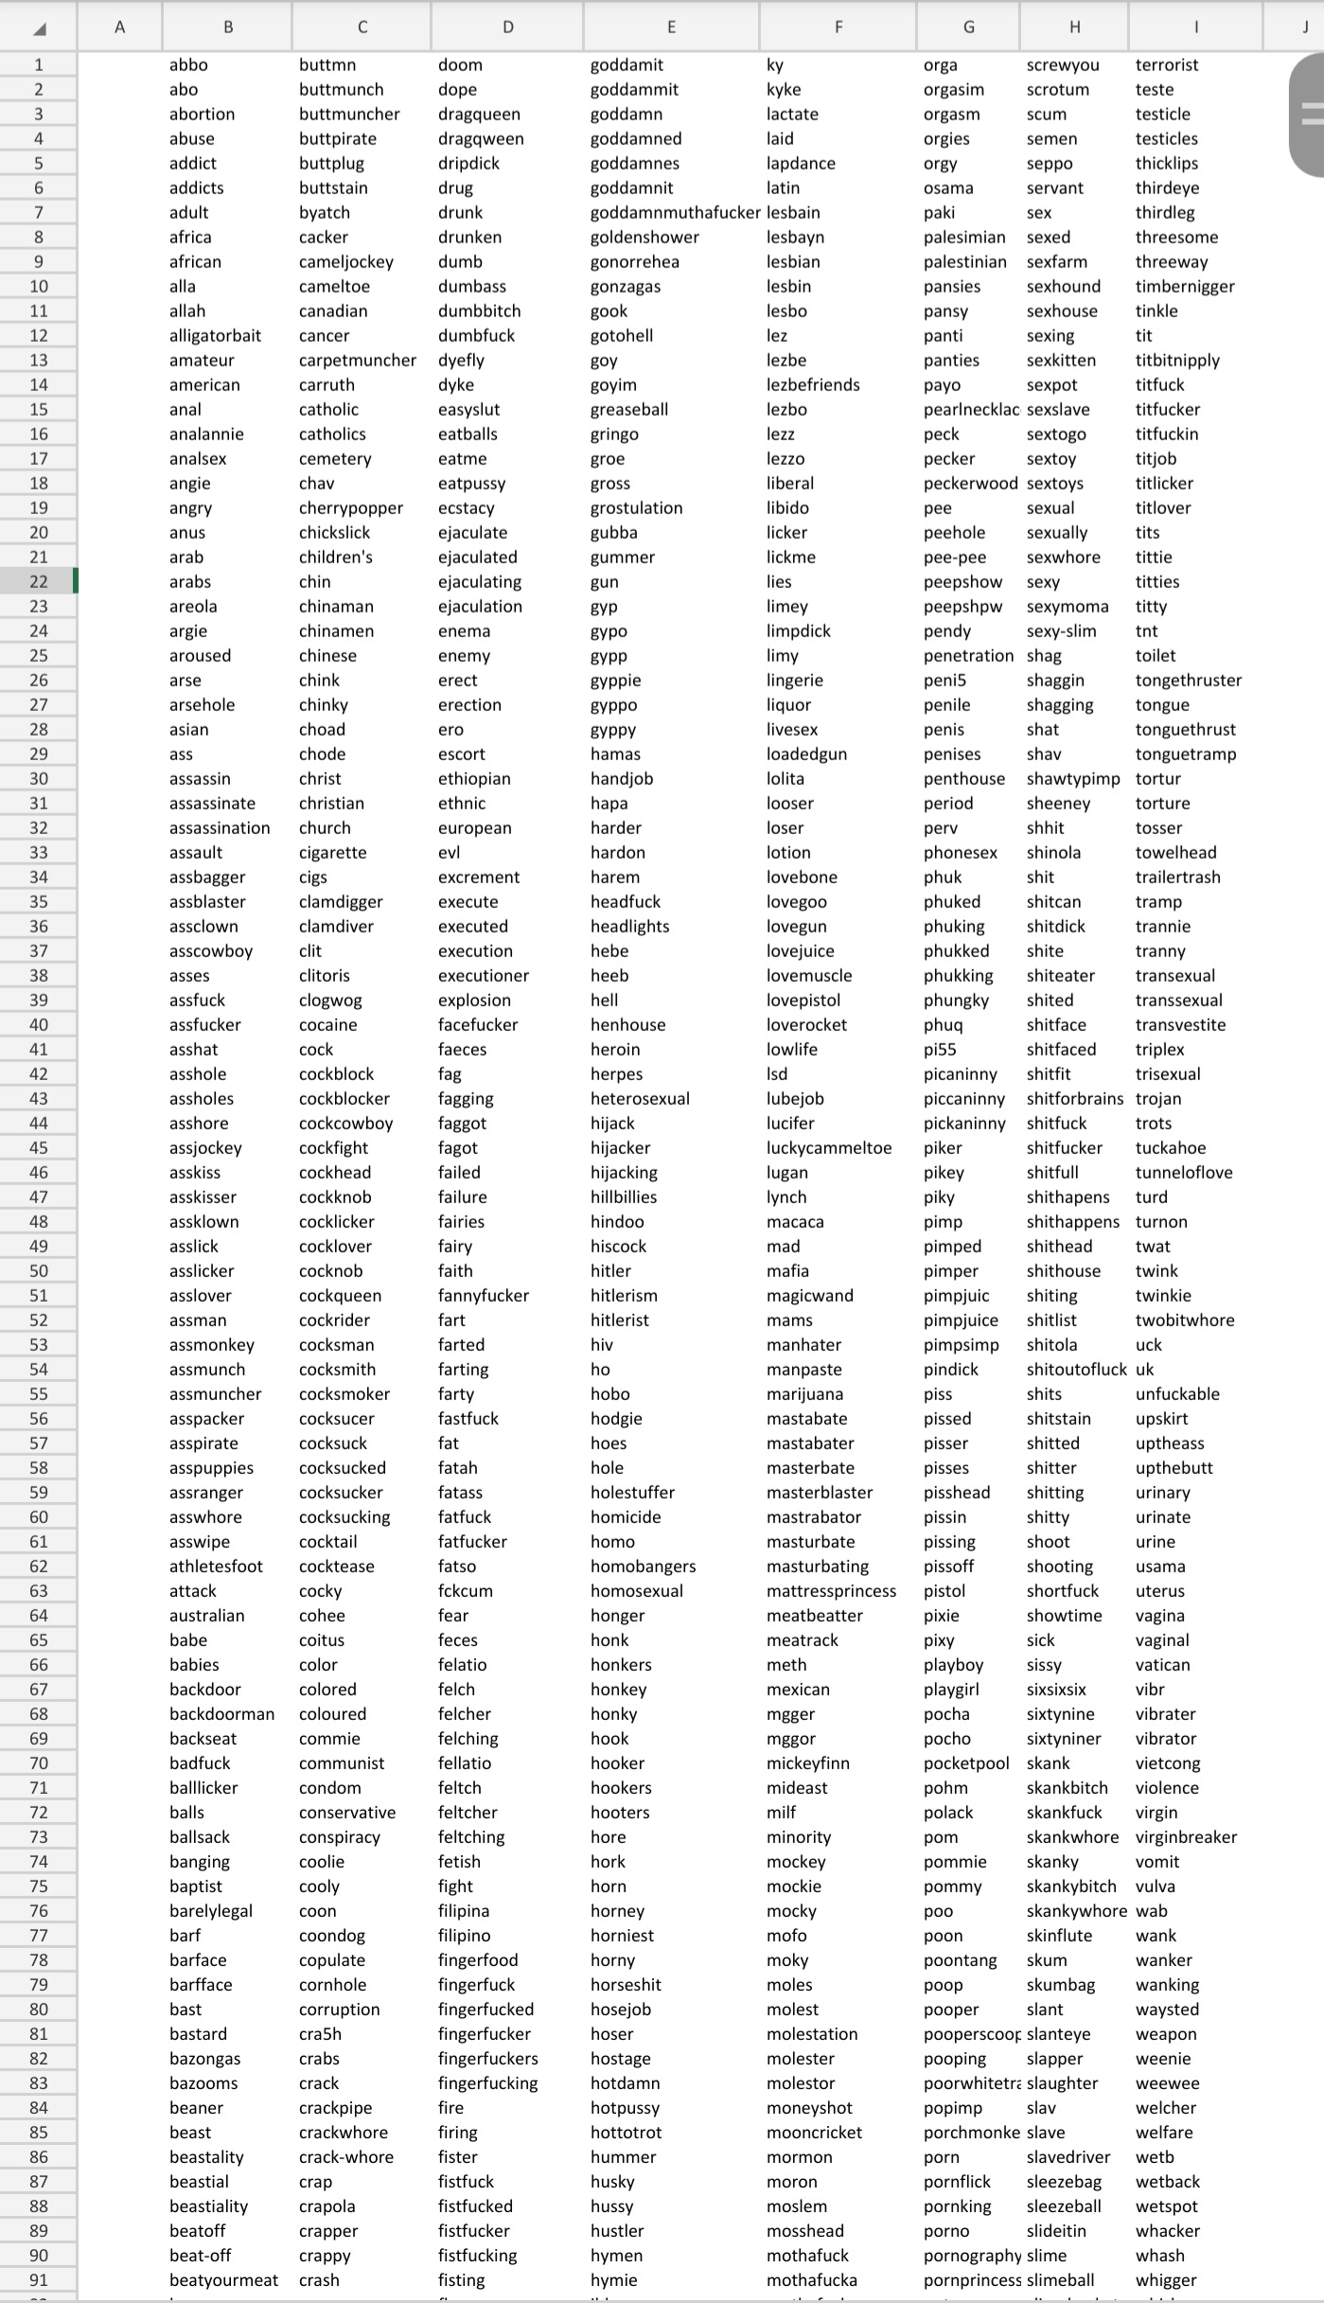
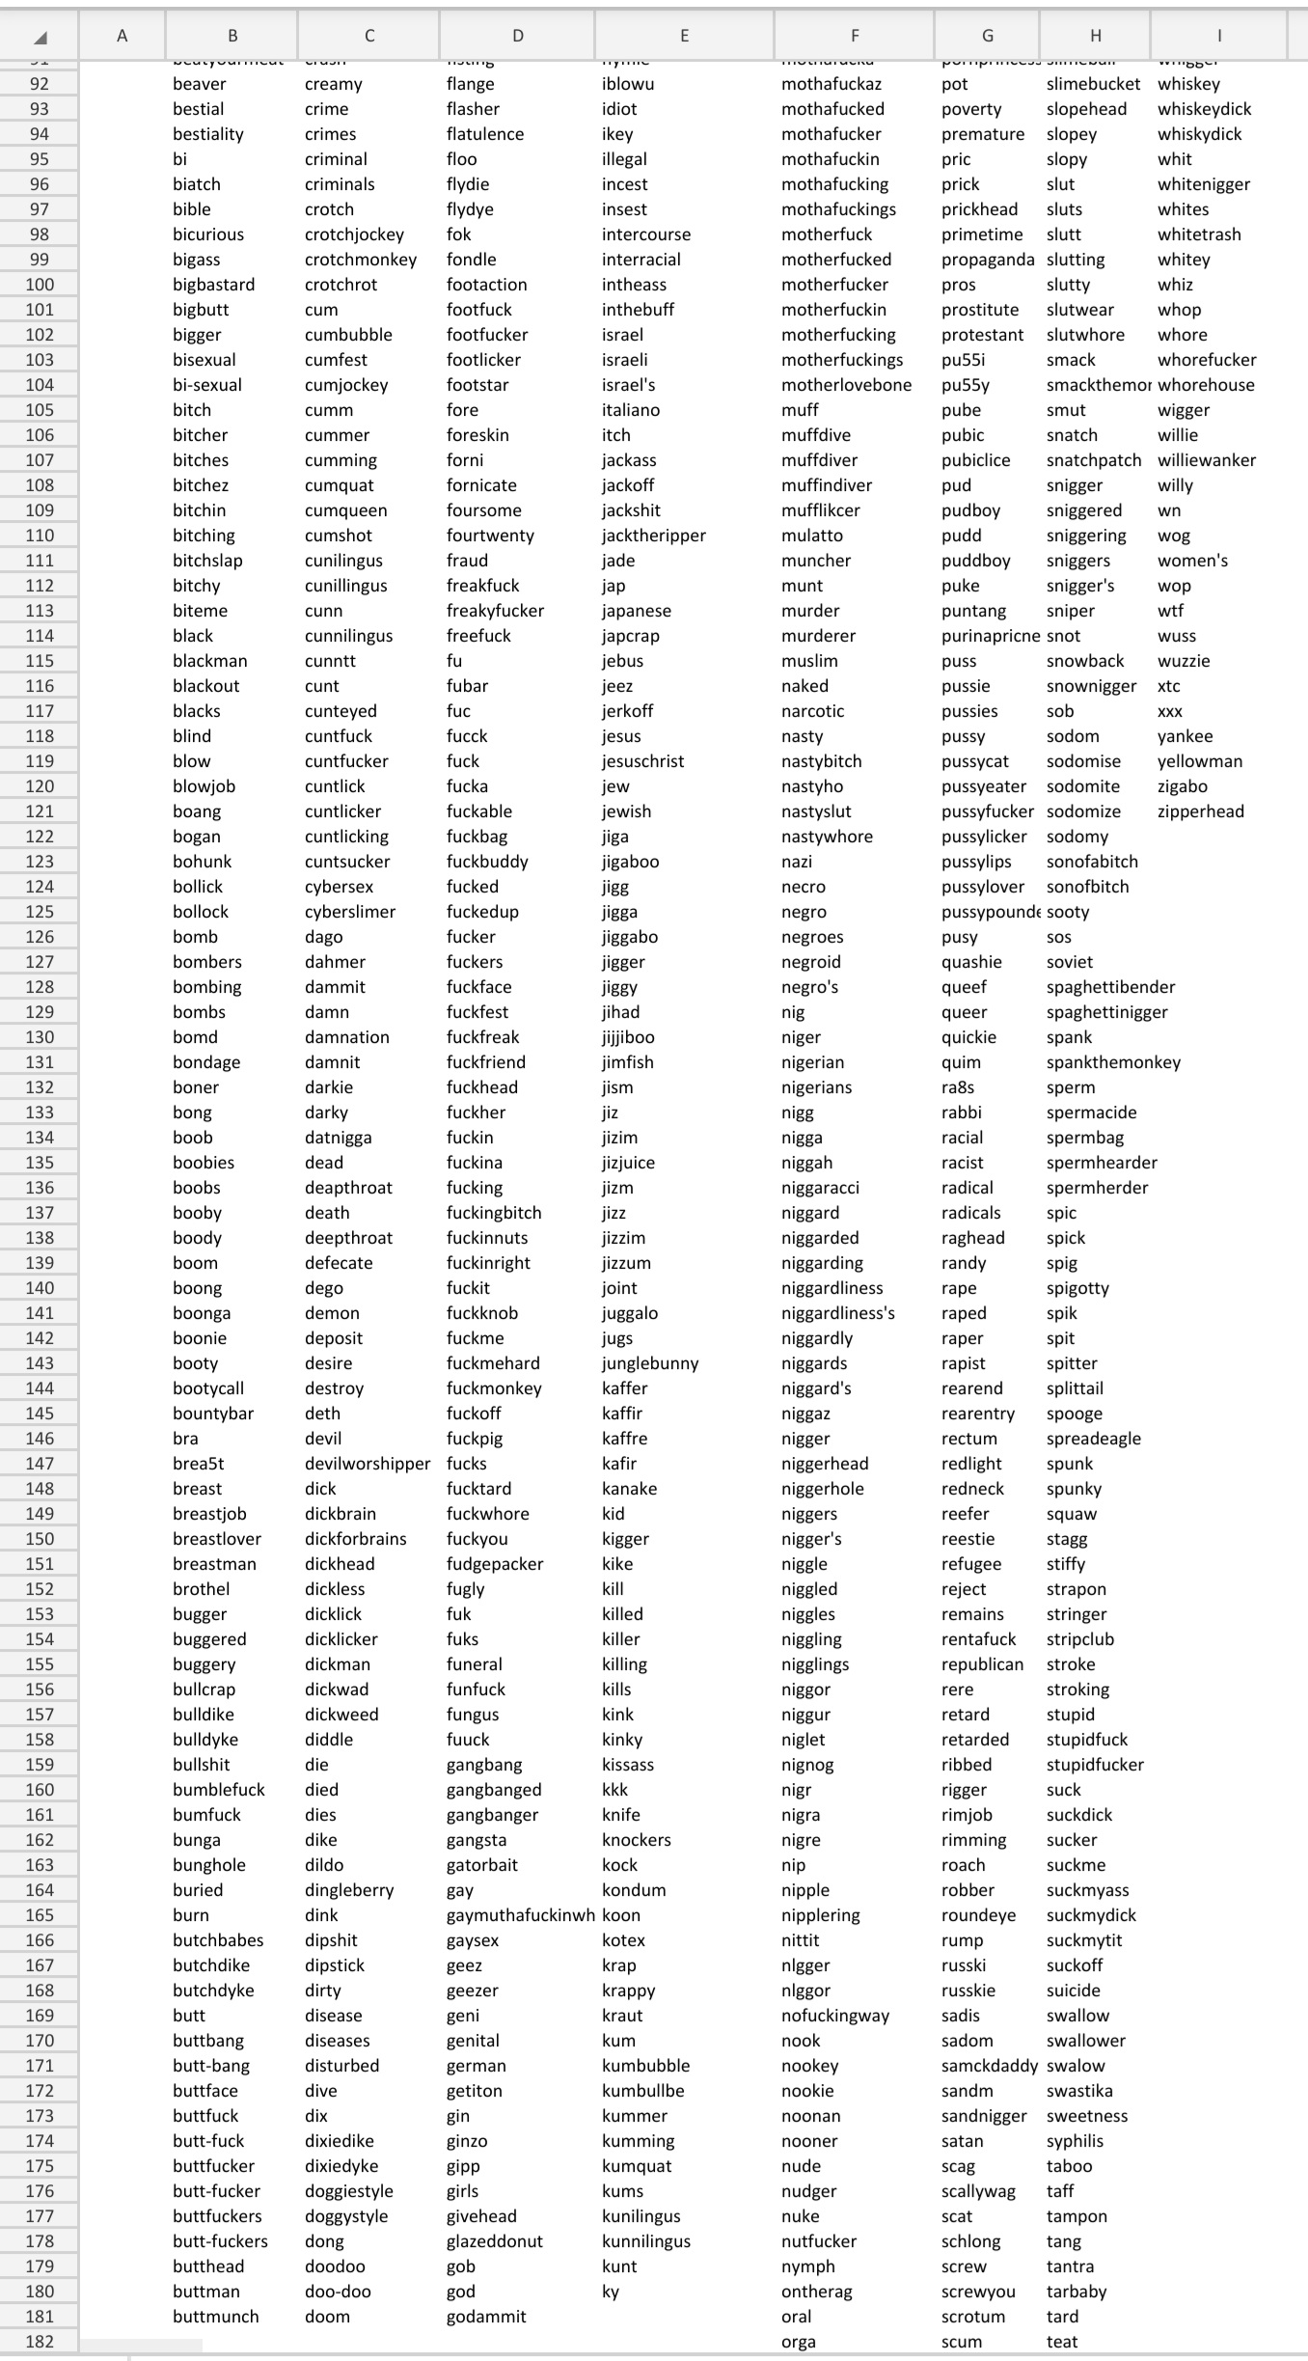
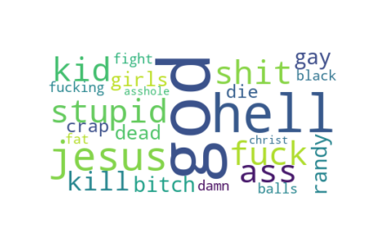
The Swear List
Notes:
Lynne

Slide 11
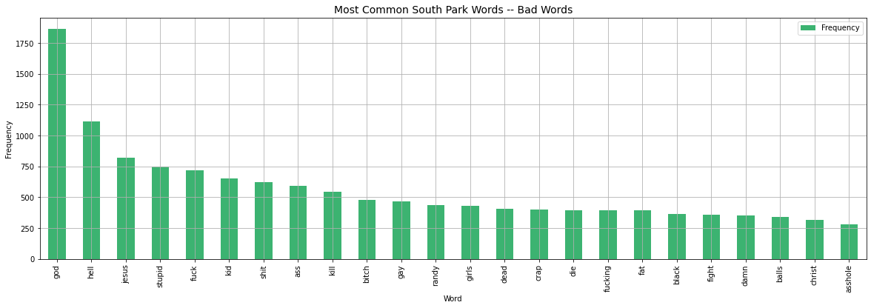
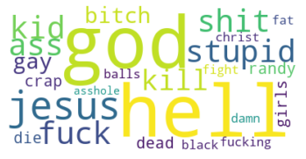
The Swear List by Frequency
Notes:
Lynne

Slide 12
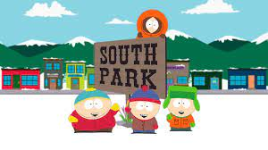

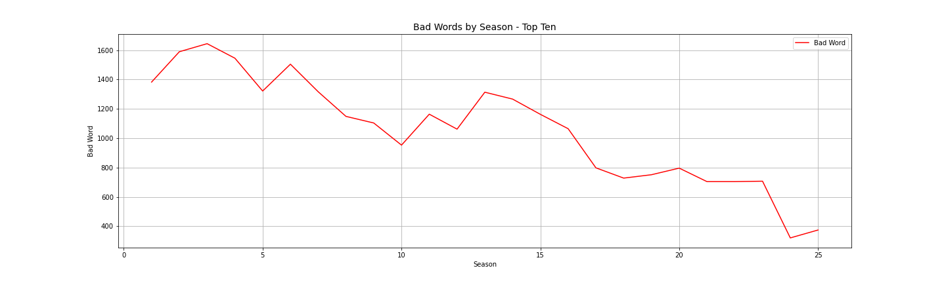
Swear Words by Season
Notes:
Lynne

Slide 13

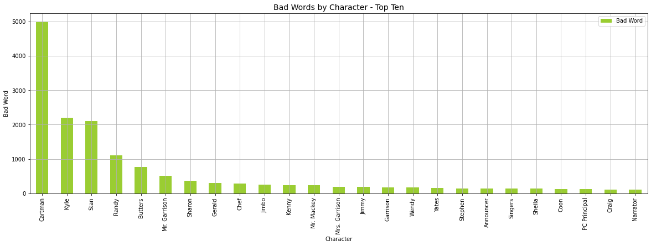
Swear Words by Character
Notes:
Lynne

Slide 14

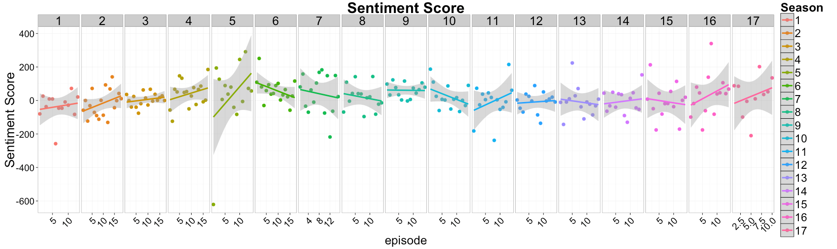
Words Sentiment Over Seasons
Notes:
We used TextBlob sentiment analysis that measures both the subjectivity and polarity of the data.

Slide 15
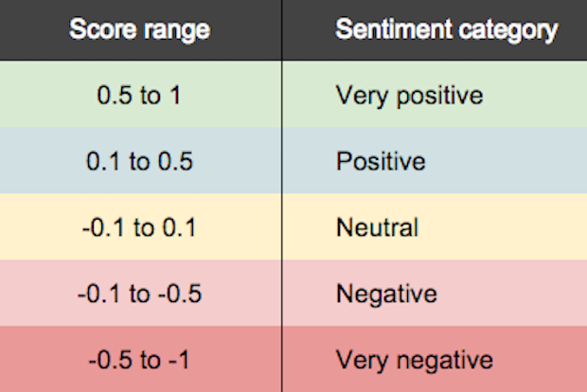
TextBlob Sentiment Analysis Scoring
Notes:
We used a library called TextBlob which is built on top on NLTK. (Natural Language Toolkit) it has a lot of functionality including sentiment analysis that measures both the subjectivity and polarity of the data. The Textblob sentiment analysis scores the polarity score, between (-1.0 and 1.0). Where -1 is the most negative language and +1 is the most positive language. So any score below zero is viewed as negative and conversely any score above zero is positive.

Slide 16

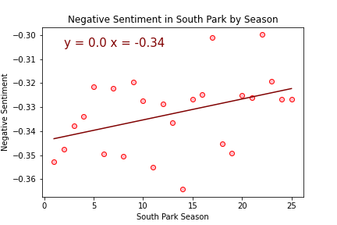
Polarity Sentiment Over Seasons
Negative Sentiment Over Seasons
Notes:
These next few slides are the plots to the data. We separated out all words that scored >0 and plotted them as the output of Negative Sentiment over all 25 seasons. As you can see the show has gotten slightly less negative over time.

Slide 17

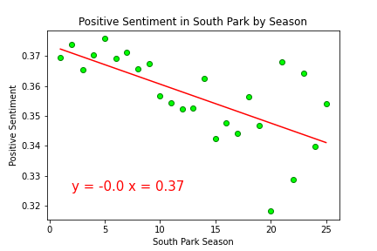
Positive Sentiment Over Seasons
The r-squared is: 0.713
Notes:
Then we separated out all words <0 and plotted them as Positive Sentiment. So, these are the positive words parsed out over Seasons 1-25. Though the positive sentiment has gotten less positive it is not indicative of the show becoming more offensive.

Slide 18
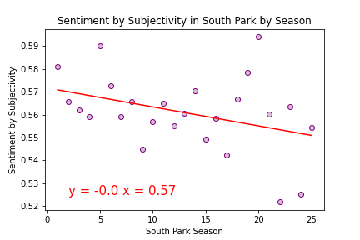
Subjectivity Over Seasons
Notes:
We also have to consider the subjectivity. Textblob also scores how subjective, or opinionated a word is. A score of 0.0 indicates that the text is very factual and a score of 1.0 indicates that the text is very subjective. As you can see not many facts in Southpark.

Slide 19

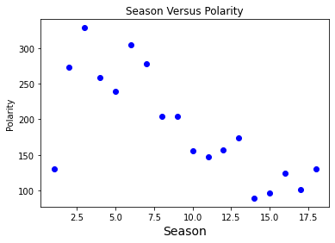
Polarity over Seasons
Notes:
Lastly, this is the average polarity score over all the seasons.

Slide 20
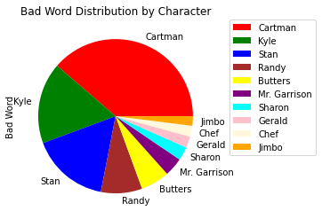
Swear Words by Character
Notes:
We have a couple of fun visuals here this is just the Swear words by character. Cartman and Kyle taking
Up roughly 65% of all curse words in the show.

Slide 21
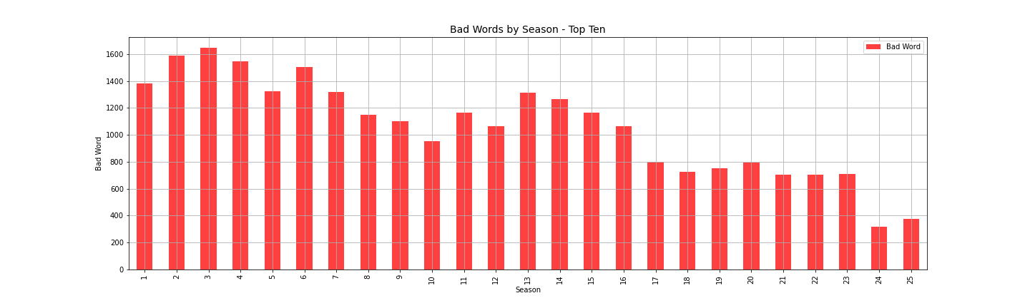
Swear Words by Season
Notes:
Here we are again with just a bar graph representing the offensive words over time or season and we can we that
The amount of offensive words has gotten reduced greatly both over time and particularly when compared the first
Three seasons with the last two.

Slide 22
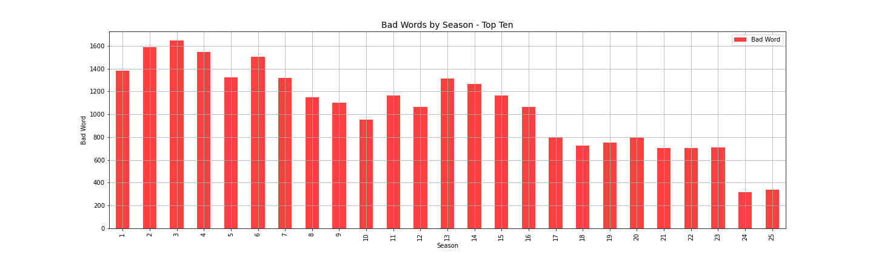
Conclusion:
We reject our Null Hypothesis: South Park has not changed at all over time (H0: M in M = 0). In favor for the Alternative Hypothesis 1: SouthPark has become less offensive over time (HA1: M < 0).
Notes:
Ronnie
Since we were particularly interested in the offensiveness over time after we parsed out all offensive words and used those as our corpus.
The textblob sentiment analysis indicates that negative dialogue has become less offensive and frequent as SouthPark has grown.
This is also observed visually in last bar graph as the use of swear words has dramatically decreased. Thus we reject our Null Hypothesis: That South Park has not changed at all over time. In favor for the Alternative Hypothesis #1: SouthPark has become less offensive over time where M which is the slope has become less than 0).

Slide 23
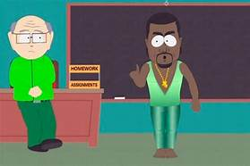
Limitations:
Initially Kaggle had only seasons 1-18
VBA Scripting to Scrape Data Seasons 19-25
COVID in 2020
Sentiment Analysis and context
Only used one Sentiment Analysis
Notes:
1.
2.
3.
4. Textblob: finds all the words and phrases that it can assign a polarity and subjectivity to and averages them together.
Textblob: Is not the most sophisticated technique, this is NOT machine learning here, it doesn’t understand context. It is strictly a rules based technique though it Is a good starting point if you want some decent sentiment analysis.
5. Better statistical methods would be Naïve Bayes or Vader Sentiment.

Slide 24
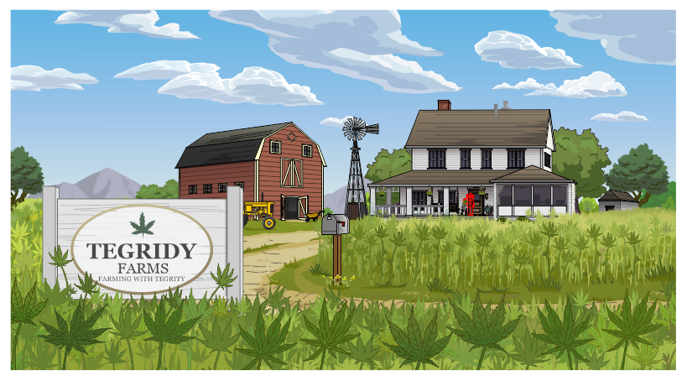
Resources:
South Park Dialogue: More than 70,000 lines of dialogue by season, episode, and character.” via Kaggle
TextBlob, NLTK, Sklearn, TermColor, Better_Profanity, TfidVectorizer, TweetTokenizer as well as matplotlib, pandas, numpy,.
3. Google Images South Park Characters
4. Seasons 18-25; Fandom: https://southpark.fandom.com/wiki/So uth_Park_Archives

Slide 25
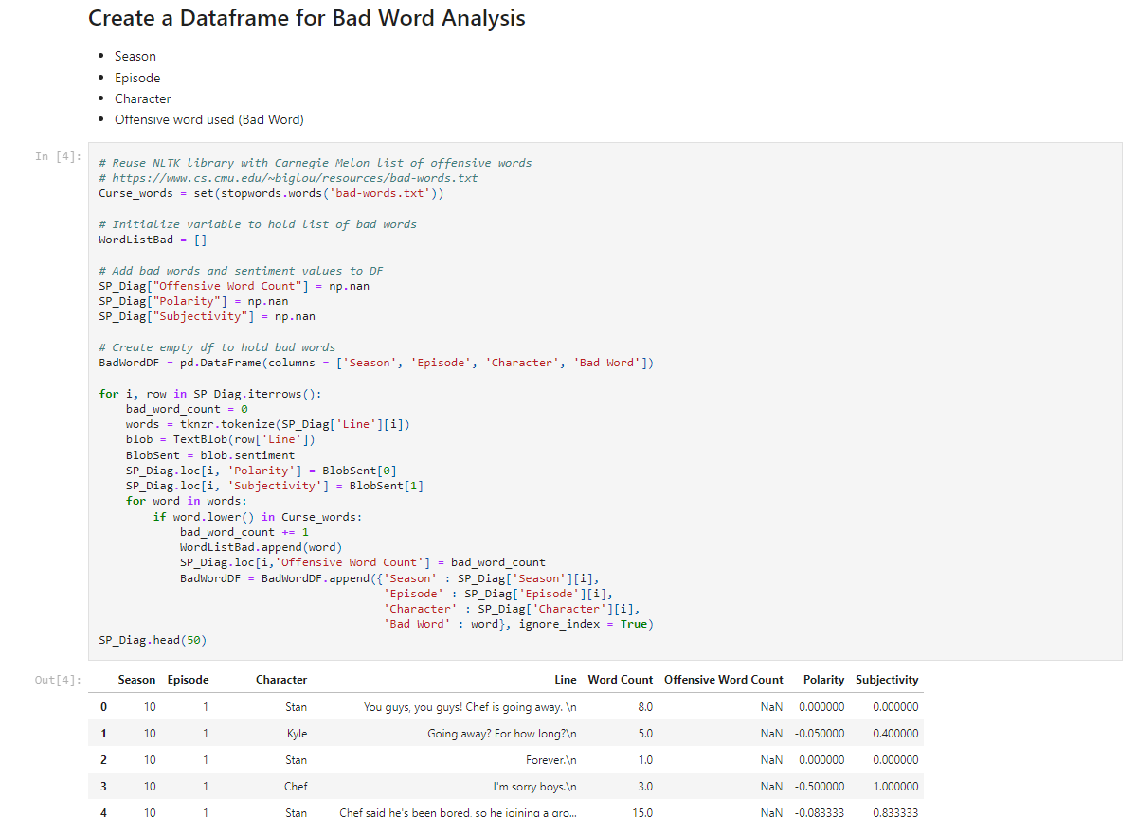
Code for Bad Word Analysis Dataframe
Notes:
Ronnie

Slide 26
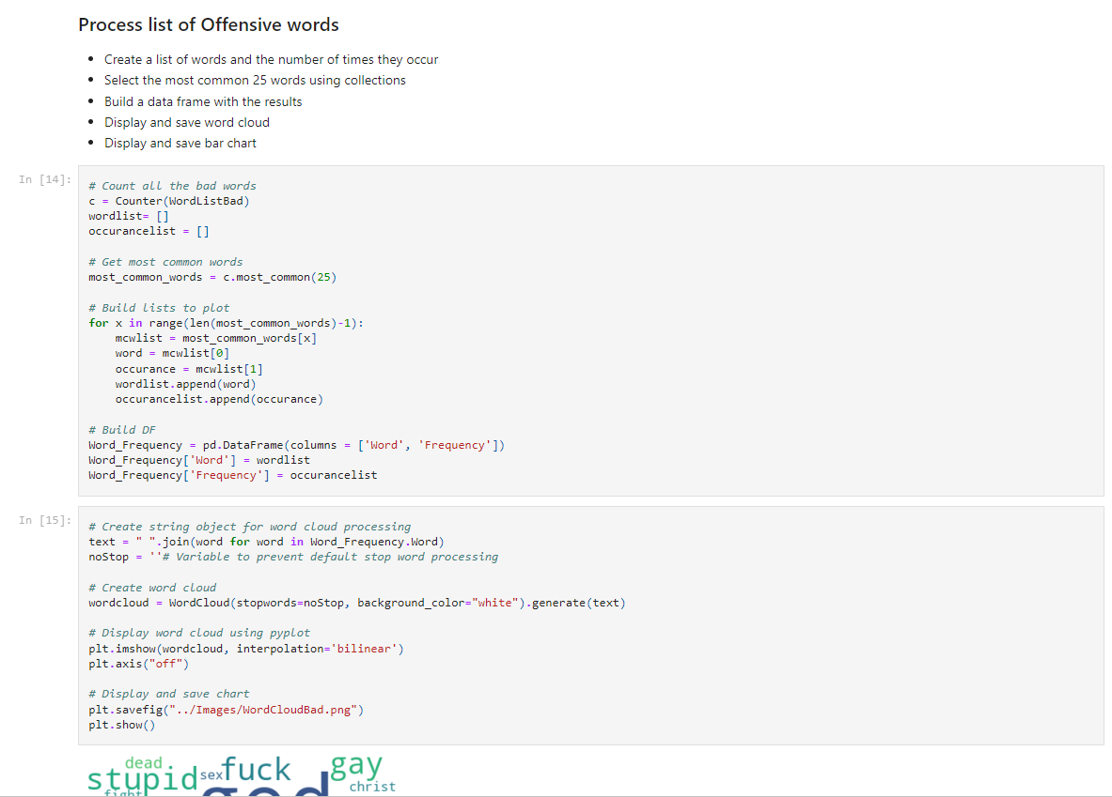
Code for Cleaning Offensive Words
Notes:
Ronnie

Slide 27
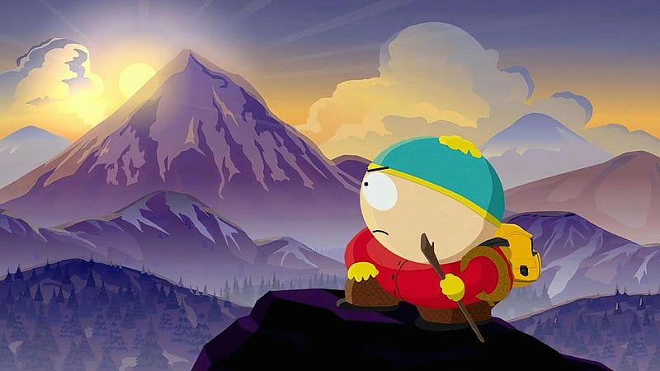
Any Questions?
Notes:
Nashra, Ronnie, Lynne, Rashmi

Slide 28

Lynne, Rashmi, Nashra, and Ronnie

